Slide 1
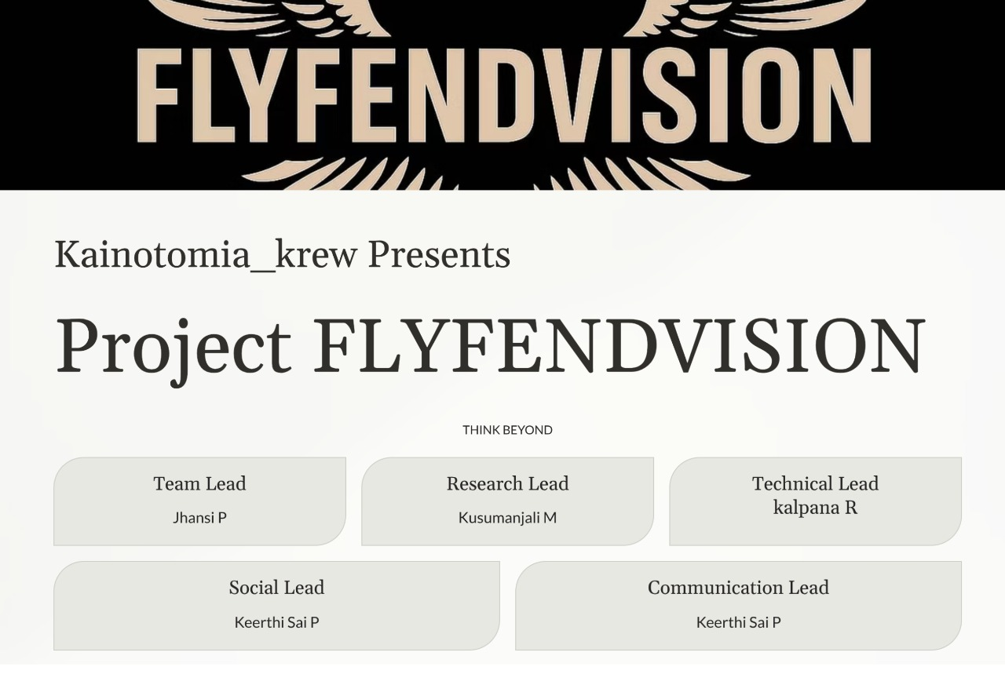

Slide 2

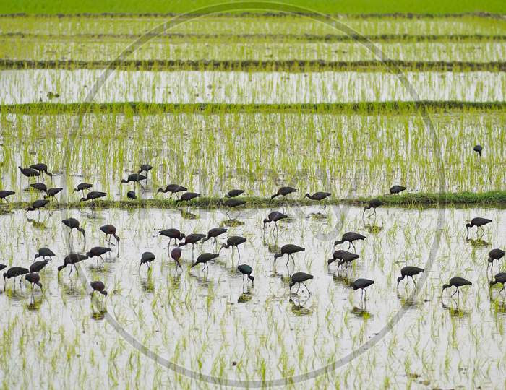
Problem statement
Crop damage caused by birds in open agricultural fields results in major losses for farmers. Manual monitoring is time-consuming, labor-intensive, and cannot ensure continuous protection.

Slide 3

Existing solutions
Here are some simple existing solutions to your bird problem 👇
Scare crow: A human-shaped dummy used to scare birds, but birds get used to it over time.
2 . Reflective Tapes & CD s: Hung around fields to reflect sunlight and scare birds visually.
3. Sound Deterrents : Speakers play loud or predator sounds to keep birds away
4. Netting : Covering crops with plastic or nylon nets to stop birds from landing.
5.Laser Lights : Laser beams are used at night to scare birds without harming them.

Slide 4

⁠Proposed Solution
1. System Setup
The system is installed at the center of the farm field. A rotational motor is fixed firmly on the ground, and two long sticks are attached to it in a V-shape. On the top of these sticks, two eagle decoy models are placed.
2. Movement and Effects
When the motor rotates, both eagle models rotate along with it. The eagles are fitted with blinking wings and realistic eagle sound effects to make them appear more lifelike and to effectively scare away birds.
3. Monitoring System
An ESP32 camera is connected to the setup for continuous monitoring of the field. This allows farmers to keep track of bird activity and system performance in real time.
4. Mobile Control
The system can be turned ON or OFF remotely using a mobile device, providing easy control and operation from anywhere.
5. Energy Management
The system is designed to rotate using wind speed, which helps in generating and storing energy. This stored energy can be used to power the system, making it more energy-efficient and sustainable.

Slide 5
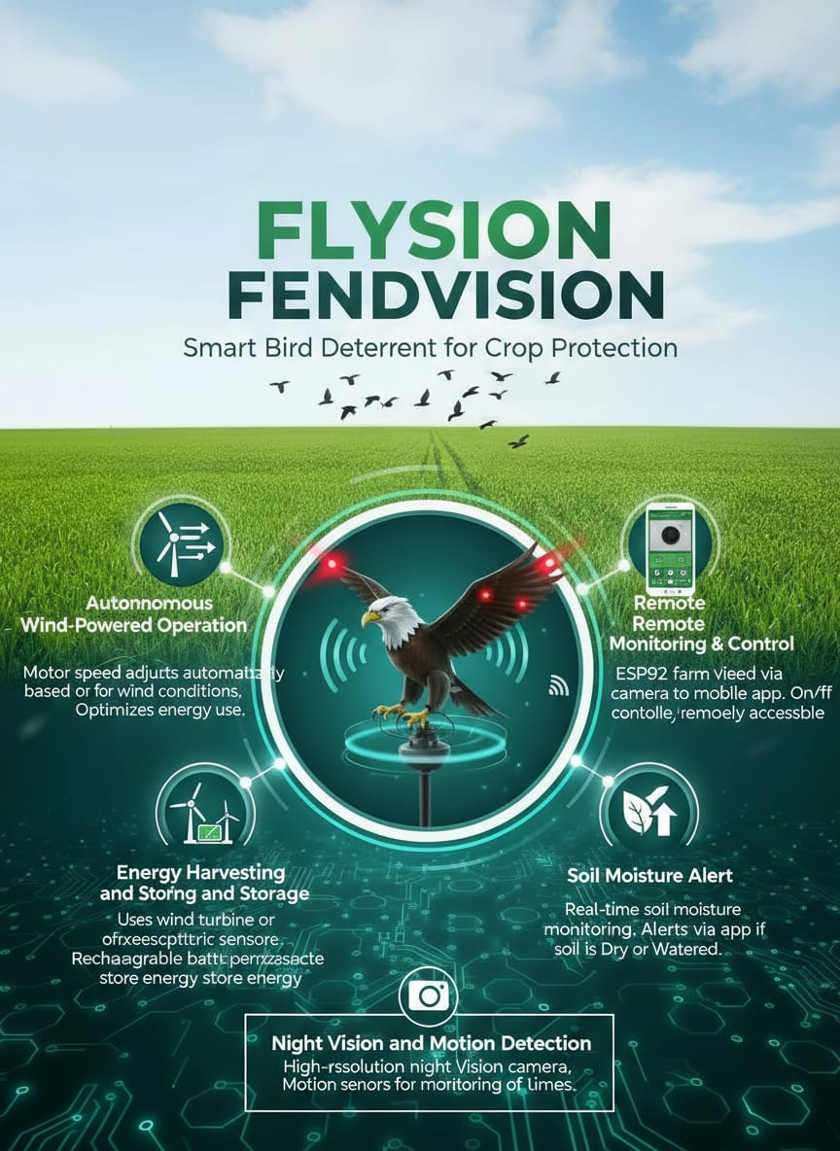
Features

Slide 6

Technologies and Tools
⚙ Technologies Used:
IoT (for monitoring and control
Automation system
Renewable energy (solar & wind)
Embedded systems (ESP32, sensors)
🧰 Tools & Components:
ESP32-CAM
Motor
Solar panel
Battery
Buzzer

Slide 7
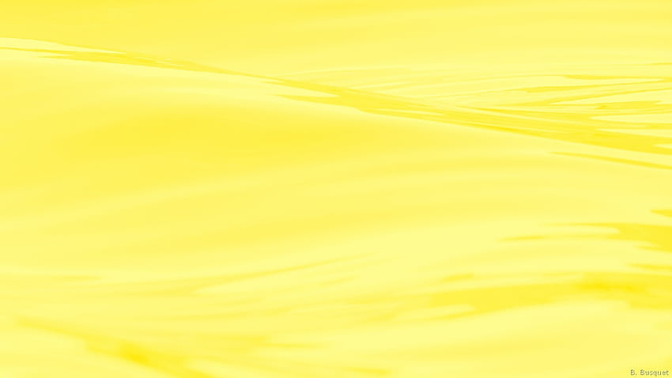
Architecture
Power Unit:🔋 Solar panel + wind turbine → gives power to the system
Control Unit:⚙ ESP32-CAM → controls motor, LEDs, and sound module
Deterrent Unit:🦅 Rotating V-shaped rod → holds eagle models with LED wings and sound
Monitoring Unit:📷 ESP32-CAM → captures live video of the field
IoT Dashboard:🌐 Displays live feed and allows ON/OFF control through mobile or web

Slide 8

Work Flow
Solar & Wind Power
↓
Battery & Power Management
↓
ESP32-CAM + Motor Control
↓
Rotating V-shaped Rod
↓
Eagle Decoys (LED Wing Blink + Sound)
↓
Birds get scared and fly away
↓
ESP32-CAM sends live video to IoT Dashboard

Slide 9

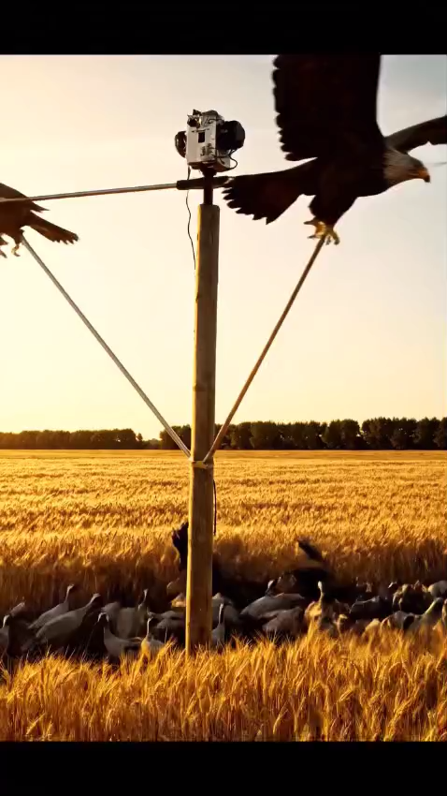
Result
The system scared birds safely and protected crops.
It worked well using solar power and gave live camera view

Slide 10

Conclusion
The Smart Bird Deterrent System helps farmers protect crops in an eco-friendly way. It is low-cost, automatic, and safe for birds while improving farm productivity.

Slide 11


